Slide 1


Slide 2
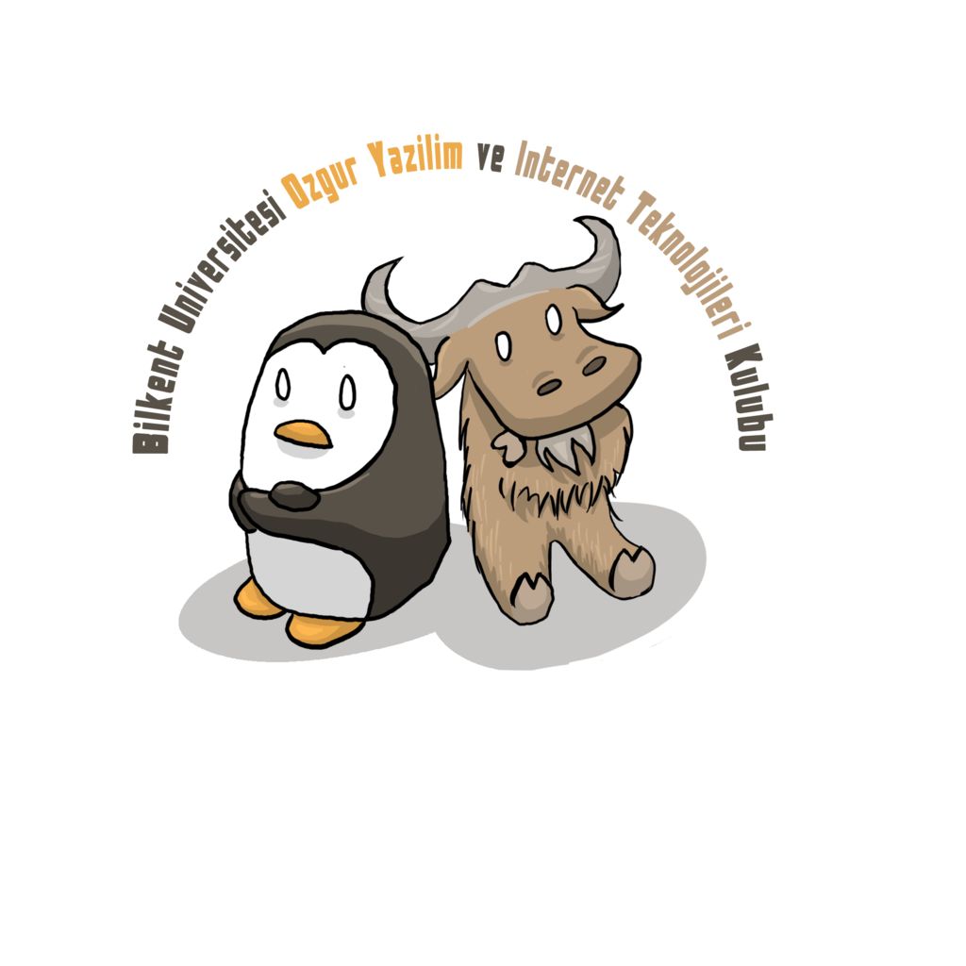
#whoami

Slide 3
Engineering
Application and practical knowledge
Invent, innovate, build, improve, maintain etc.
Academic Discipline (higher education)
https://en.wikipedia.org/wiki/Category:Engineering_disciplines

Slide 4
Reverse Engineering
Back Engineering.
Extraction of the methodology, structure etc.
Patents require public disclosure.
https://en.wikipedia.org/wiki/Reverse_engineering#Reverse_engineering_for_military_applications
Human Genome

Slide 5
Example Projects
Wine
Samba
OpenOffice & LibreOffice
ReactOS

Slide 6
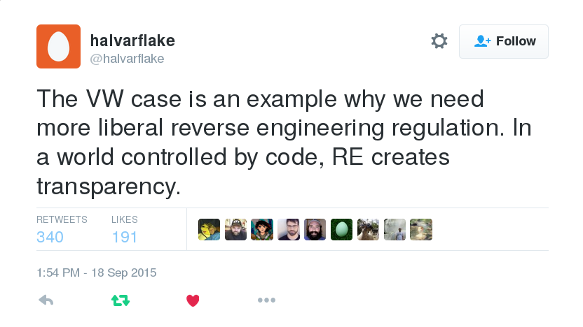
Transparency

Slide 7
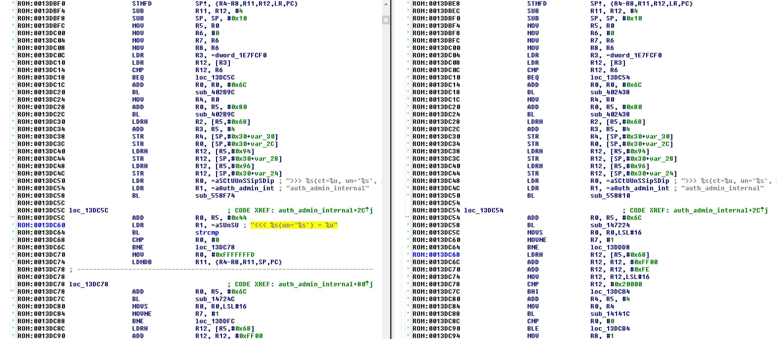
Backdoors Everywhere

Slide 8
Backdoors Everywhere
Fortinet Response: "This was not a 'backdoor' vulnerability issue but rather a management authentication issue. The issue was identified by our Product Security team as part of their regular review and testing efforts."

Slide 9
Antiviruses
When you install Comodo Internet Security, in the default configuration an application called "GeekBuddy" is also installed and added to HKLM\System\CurrentControlSet\Services. GeekBuddy is a tech support application, that uses a number of questionable and shady tactics to encourage users to pay for online tech support.
https://bugs.chromium.org/p/project-zero/issues/detail?id=703&redir=1
http://www.joineset.com/jobs-analyst.html

Slide 10
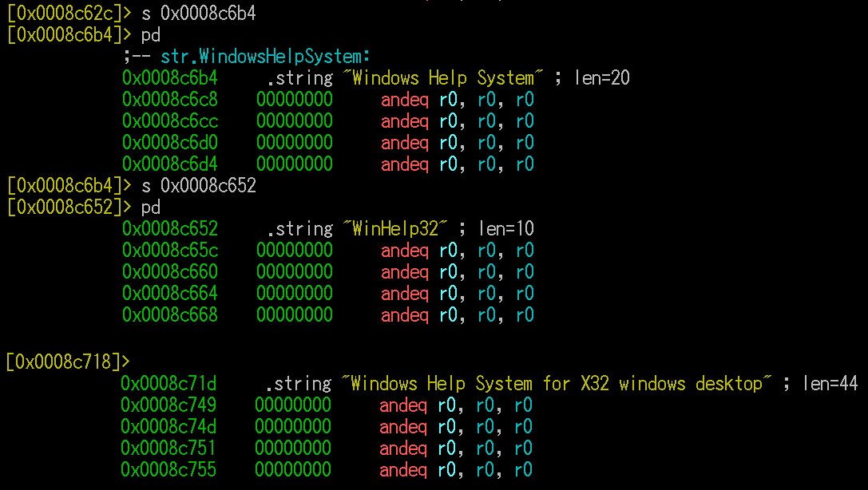
Malware

Slide 11
Exploit Development
http://www.0day.today
https://www.exploit-db.com/
https://java-0day.com/
http://www.zerodayinitiative.com/

Slide 12
Copy Protections
Different from Crack Protection
“Crack protection is more about out-thinking the crackers than out-coding them.”
“First we looked at the copy protection: was there any way to reduce its vulnerability to cracking? We could call the copy protection multiple times throughout the game, making it harder to bypass. Unfortunately, the copy protection requires exclusive access to the CD for about 10 seconds, which is an eternity when you are waiting for a level to load. So that was out of the question.”
http://www.gamasutra.com/view/feature/131439/keeping_the_pirates_at_bay.php

Slide 13
Checksumming
Not a function, inline code.
Slightly different each time, preventing pattern searches.
DLLs crosscheck eachother.
Breakpoint detection, code behaves differently.
“Paradox, the cracking group who produced the working patch for YOTD, even thanked the "Sony coders" who added such interesting protection to the game.”

Slide 14
Environment Variables
Architecture: Intel x86, PowerPC, ARM etc.
OS: GNU+Linux, FreeBSD, Windows etc.
Virtual Environment: Java, .NET etc.
Executable File: PE, ELF etc.

Slide 15
Terminology
Static, Dynamic
Compiler
Linker
Disassembly
Debugger
Decompiler
Instruction, OPCode

Slide 16
Terminology
Obfuscation
De-Obfuscation
Anti-debugging
Anti-anti-debugging
Anti-debugger
Packer
Unpacker

